Slide 1
New Ideas Below

Slide 2


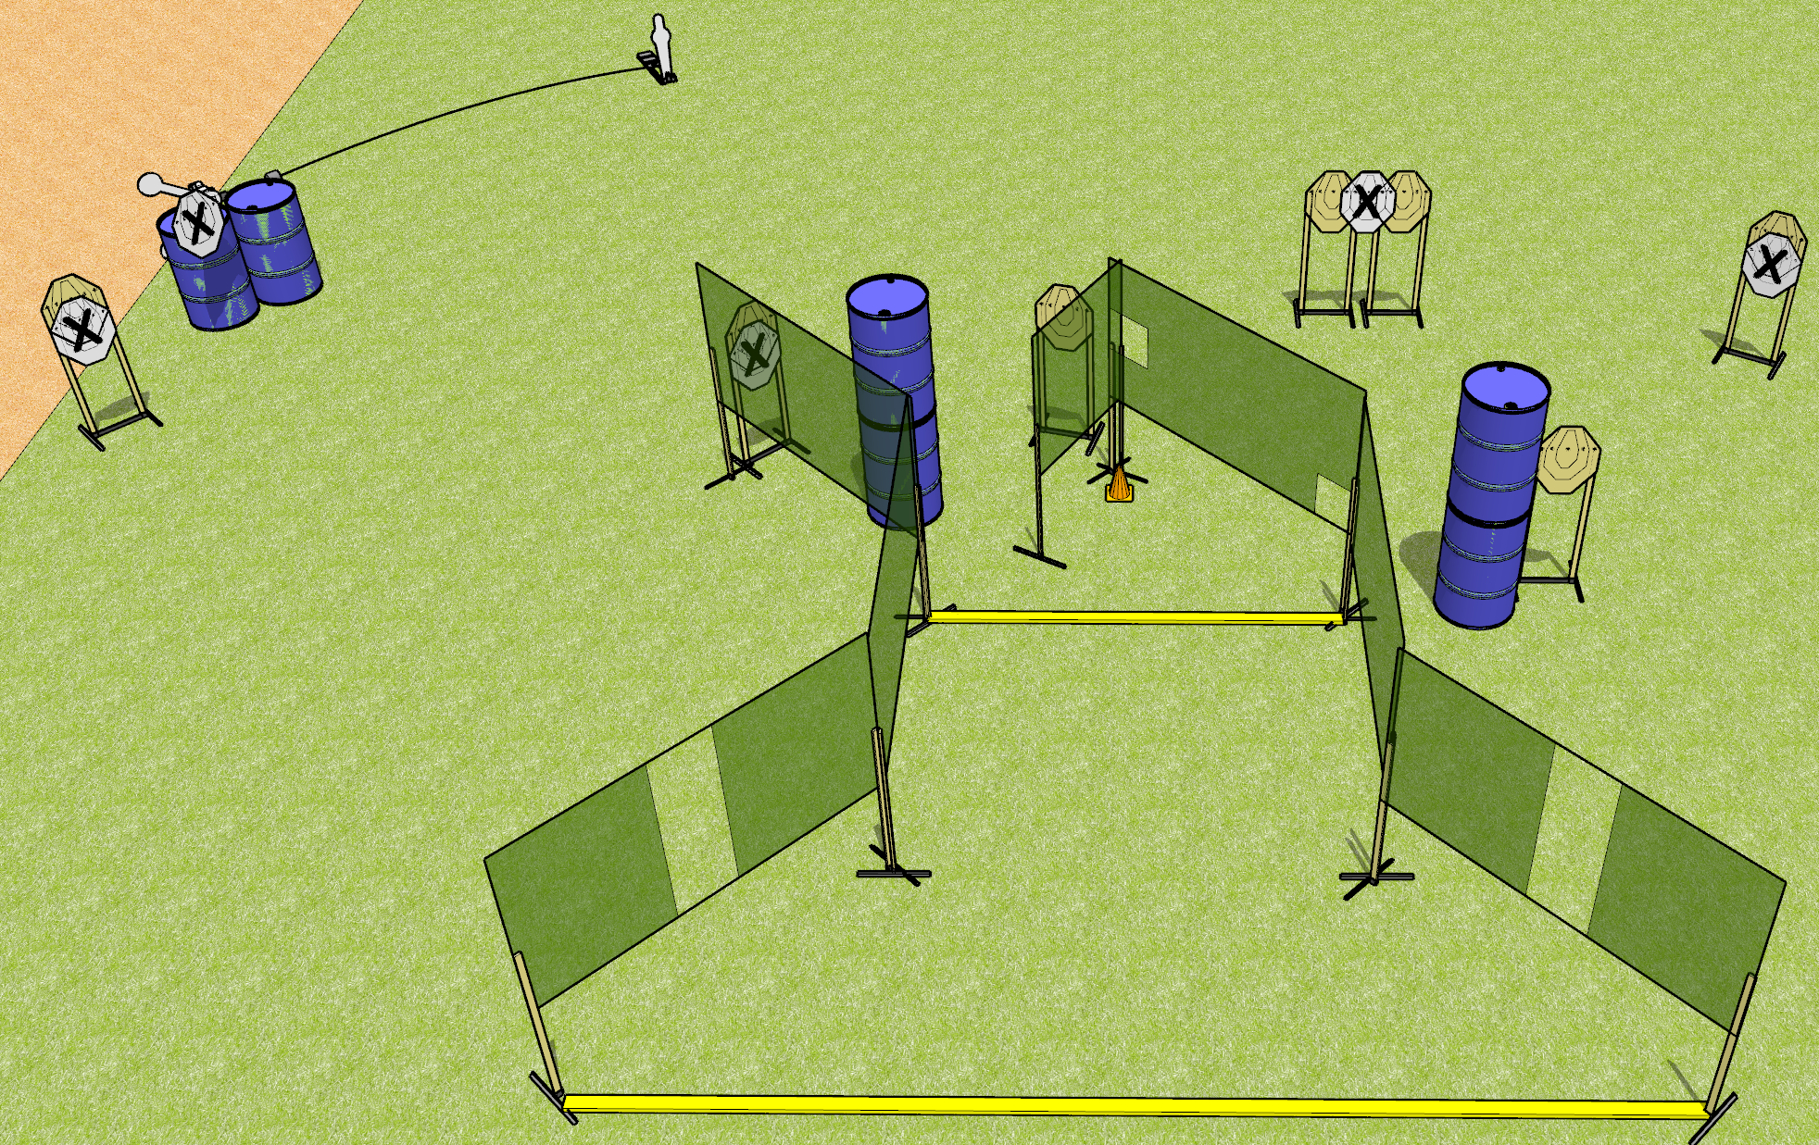
 | Dothan Gun Club – USPSA Match Three Times the Pain Course Designer : Drew Coleman
START POSITION : Standing outside the shooting area, heels on forward fault line OR toes touching rear faultline, wrists below belt
GUN READY CONDITION : Pistol loaded and holstered. PCC loaded, shouldered, safety on, pointed at orange cone. |  | SCORING: Comstock, 24 rounds TARGETS: 7 paper, 3 Steel SCORED HITS: Best 3 on paper, steel until down START-STOP: Audible, last shot RULES:
STAGE PROCEDURE: Engage targets as they become available from within the fault lines.

Slide 3
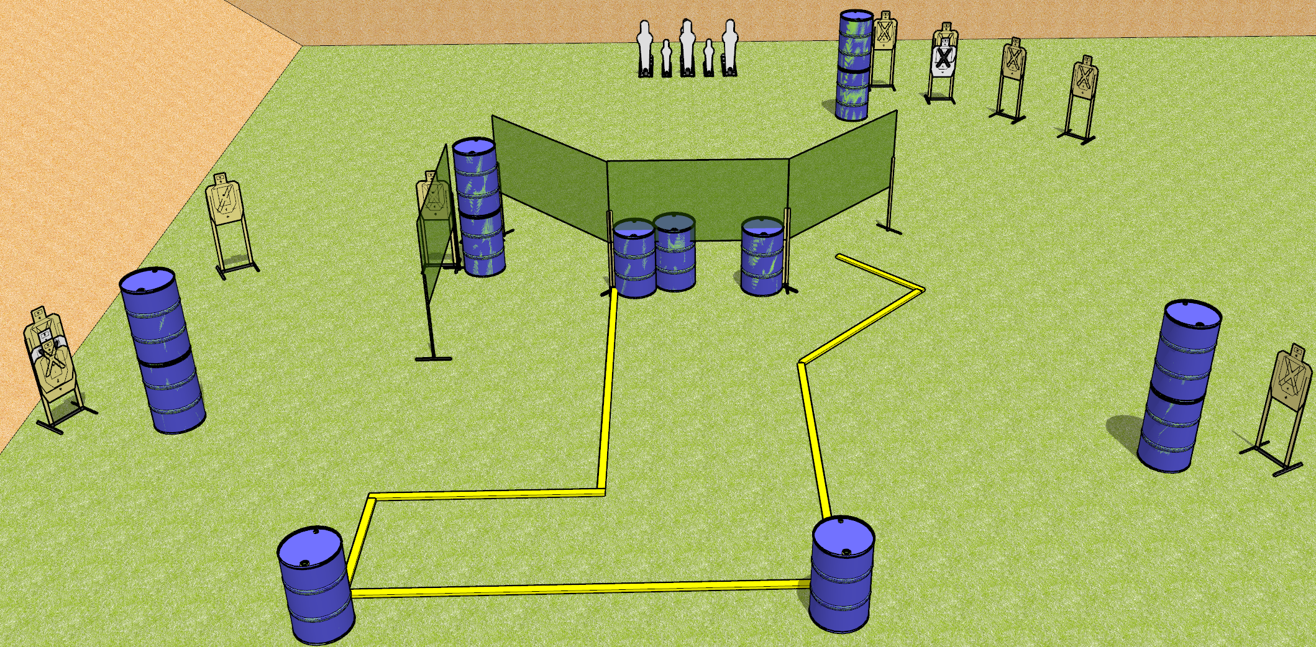
 | Dothan Gun Club – USPSA Match My Knees Hurt Course Designer : Drew Coleman
START POSITION : Standing with palms flat on top of either barrel along rear fault line, outside the shooting area.
GUN READY CONDITION : Pistol/PCC unloaded on opposite barrel from starting position. Muzzle pointed 90 degrees to the back berm, trigger guard on mark. |  | SCORING: Comstock, 26 rounds TARGETS: 10 paper, 6 Steel SCORED HITS: Best 2 on paper, steel until down START-STOP: Audible, last shot RULES: The forward center wall is as constructed and may be shot under.
STAGE PROCEDURE: Engage targets as they become available from within the fault lines.
Tuxedo

Slide 4
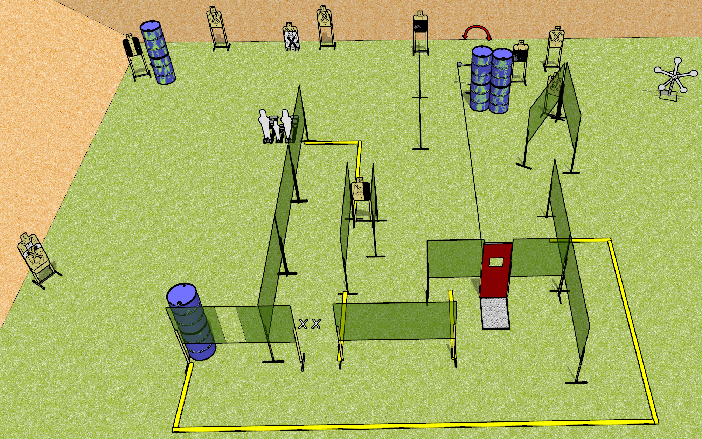
 | Dothan Gun Club – USPSA Match Don’t Mess With Me Course Designer : Drew Coleman
START POSITION : Standing with both feet on X’s, wrists below belt
GUN READY CONDITION : Pistol loaded and holstered. PCC loaded, shouldered, safety on, pointed at orange cone. |  | SCORING: Comstock, 34 rounds TARGETS: 14 paper, 8 Steel SCORED HITS: Best 2 on paper, steel until down START-STOP: Audible, last shot RULES:
STAGE PROCEDURE: Engage targets as they become available from within the fault lines.

Slide 5
Open target

